Slide 1


The “ETJM’ Project – COVID 19 ANALYSIS
Erika Hoshino
Tuflikha Putri
John Nasiakos
Mike Murphy

Slide 2
BACKGROUND
Background
Our hypothesis
Relationship between “unvaccinated” Covid patients versus “vaccinated” Covid patients for the following countries : Australia, United States, United Kingdom, New Zealand, Italy, Israel, Brazil, South Africa, Vietnam
Countries that impacted the most vs. the least
Correlation and Regression Analysis unvaccinated/vaccinated vs death rates
Conclusion and future work
Implication of this work
Q&A

Slide 3
Our hypothesis
The alternative hypothesis Ha - that there is a relationship between vaccination and death rate.
The null hypothesis H0 - that there is no relationship between vaccination rate and death rate

Slide 4
DATA EXPLORATION
1. Total number and percentage of fully vaccinated people by country
Analysis process :
Pandas to clean and format datasets;
Jupyter notebook for data exploration, clean up, and the final data analysis.
Matplotlib to create visualisation (graphs and bar charts)
2. Countries that impacted the most vs. the least
3. Correlation and Regression Analysis unvaccinated/vaccinated
vs death rates
4. Fatality ratio vs fully vaccinated people

Slide 5
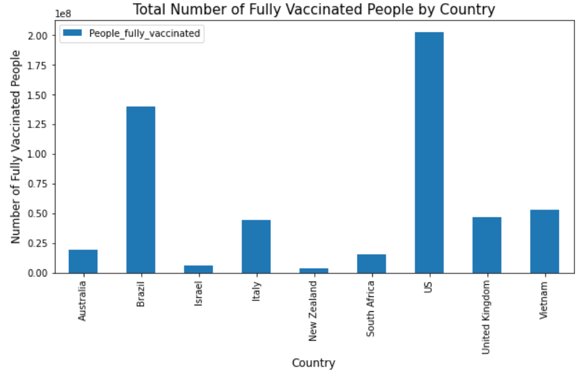
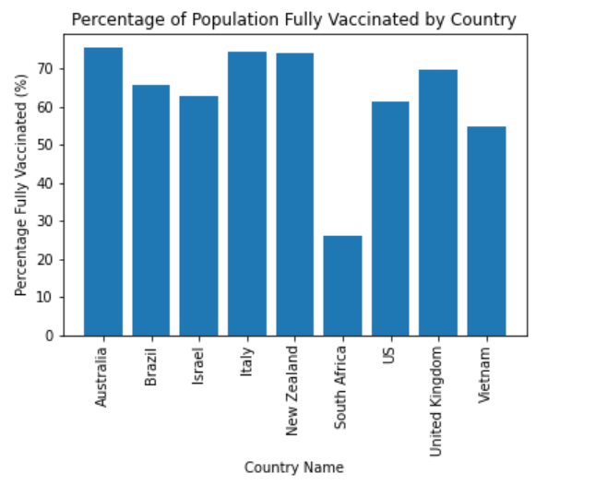
Conclusion / implications

Slide 6
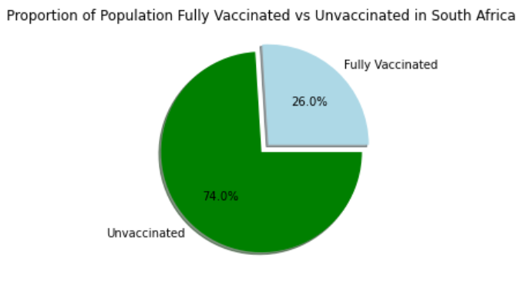
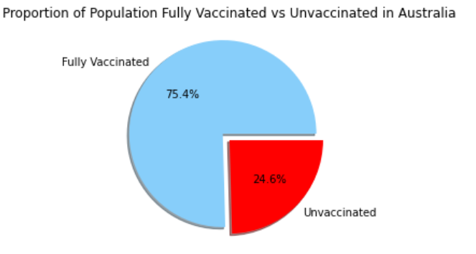
Conclusion / implications

Slide 7
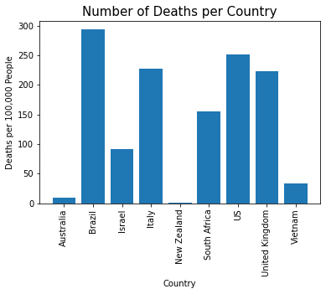
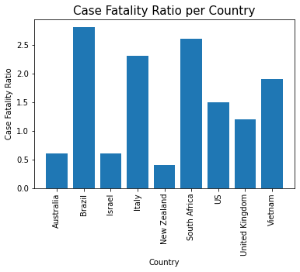
Conclusion / implications

Slide 8
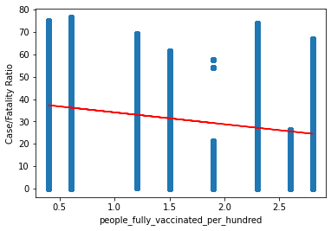
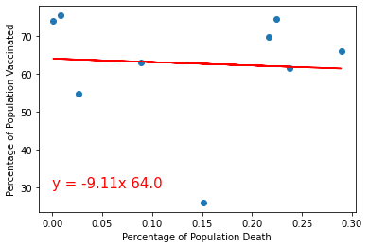
Conclusion / implications

Slide 9
IMPLICATION OF THE WORK
Vaccination reduces the deaths, deaths per 100,000 and case fatality ratio although we found that the relationship is not the significant correlation that might have been expected.
Further work needs to be done to conclude this analysis.

Slide 10
Q&A
Thank you

